Slide 1
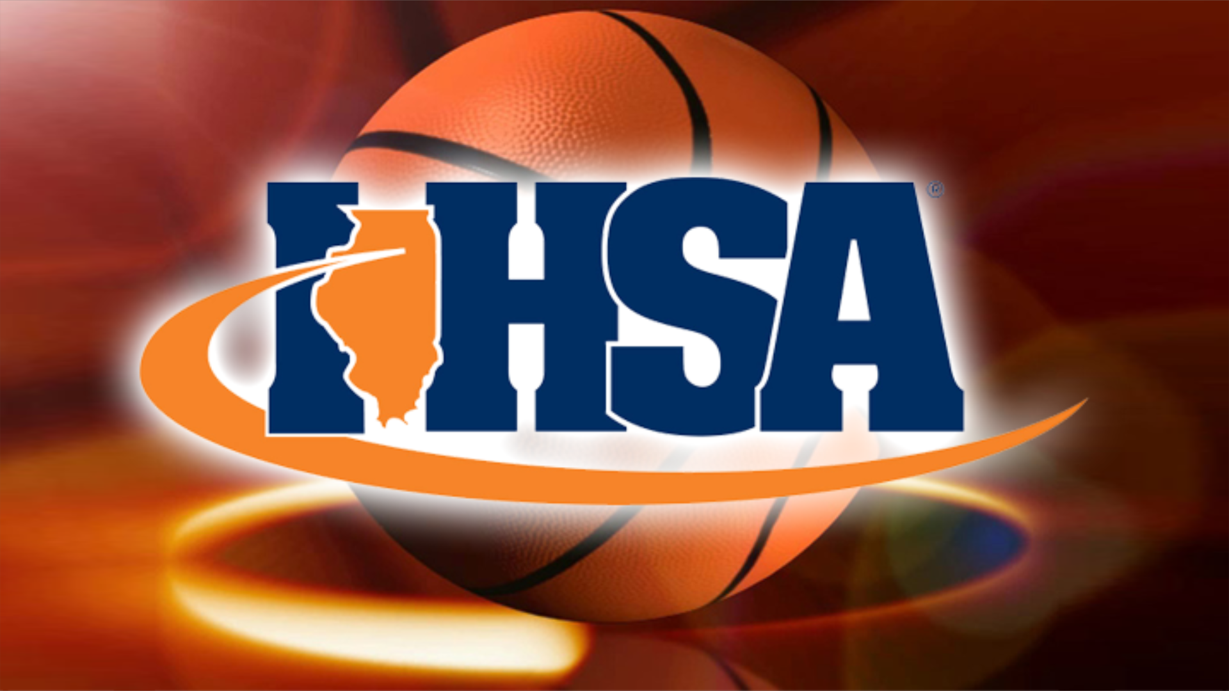
Shot Clock Information/ Implementation
2023-24 school year
Notes:
Welcome to this presentation on the use of the 35 second shot clock in Illinois during the 2022-23 season.

Slide 2
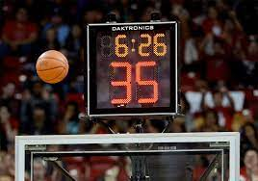
Background
Following the announcement in June of 2021 from the NFHS that allowed states to adopt a basketball playing rule to use a 0:35 shot clock, the IHSA Board of Directors surveyed coaches, school administrators, and licensed officials to gauge interest in the possible use of the rule in Illinois.
This presentation is designed to offer event organizers and officials an explanation of how to implement the rule in approved events.
Notes:
Following the announcement in June of 2021 from the NFHS that allowed states to adopt a basketball playing rule to use a 0:35 shot clock, the IHSA Board of Directors surveyed coaches, school administrators, and licensed officials to gauge interest in the possible use of the rule in Illinois. The next slide reviews the results of those surveys.

Slide 3
Background
In June of 2023, the IHSA Board of Directors approved the use of the 35- second shot clock under limited conditions for the 2023-24 school year in high school basketball in Illinois.
The NFHS model rule adopted by the IHSA is the ONLY rule that can be utilized.
ONLY regular season tournaments and shoot outs can use the model rule.
Events must be pre-approved by the IHSA Office.
Organizers and participants will be asked to complete a post-event questionnaire to assist in data collection regarding the shot clock.
The shot clock may NOT be used in regular season games or the state series.
Notes:
To quickly review, in June of 2022, the IHSA Board of Directors then authorized the use of the 35 second shot clock under limited conditions for the 2022-23 school year in high school basketball in Illinois.
The NFHS model rule is the ONLY rule that can be utilized.
ONLY regular season tournaments and shoot outs can use the model rule.
Events must be pre-approved by the IHSA Office.
Organizers and participants will be asked to complete a post-event questionnaire to assist in data collection regarding the shot clock.
The shot clock may not be used in regular season games and will not be used this year during the state series.

Slide 4
Shot Clock Request Form
Events wishing to use the shot clock must do so in conjunction with an IHSA member school. In other words, an IHSA member school must be listed as the organizer/co-organizer of any event wishing to use the shot clock.
NOTE: all games played in an approved event MUST use the shot clock.
IHSA member schools can request an approval form by contacting Kurt Gibson (kgibson@ihsa.org) at the IHSA Office.
Notes:
As we discuss the aspects of the shot clock rule, it’s important to note and realize that the rule adopted for use in Illinois is different than the collegiate rule, particular in regards to the resetting of the clock. There can be no deviations from the rule adopted by the IHSA Board of Directors and discussed in this presentation.
Events wishing to use the shot clock must do so in conjunction with an IHSA member school. In other words, an IHSA member school must be listed as the organizer/co-organizer of any event wishing to use the shot clock. Part of the approval process requires that organizers acknowledge ALL games in the tournament or shoot-out will use the shot clock. IHSA member schools can request an approval form by contacting Kurt Gibson (kgibson@ihsa.org) at the IHSA Office.

Slide 5
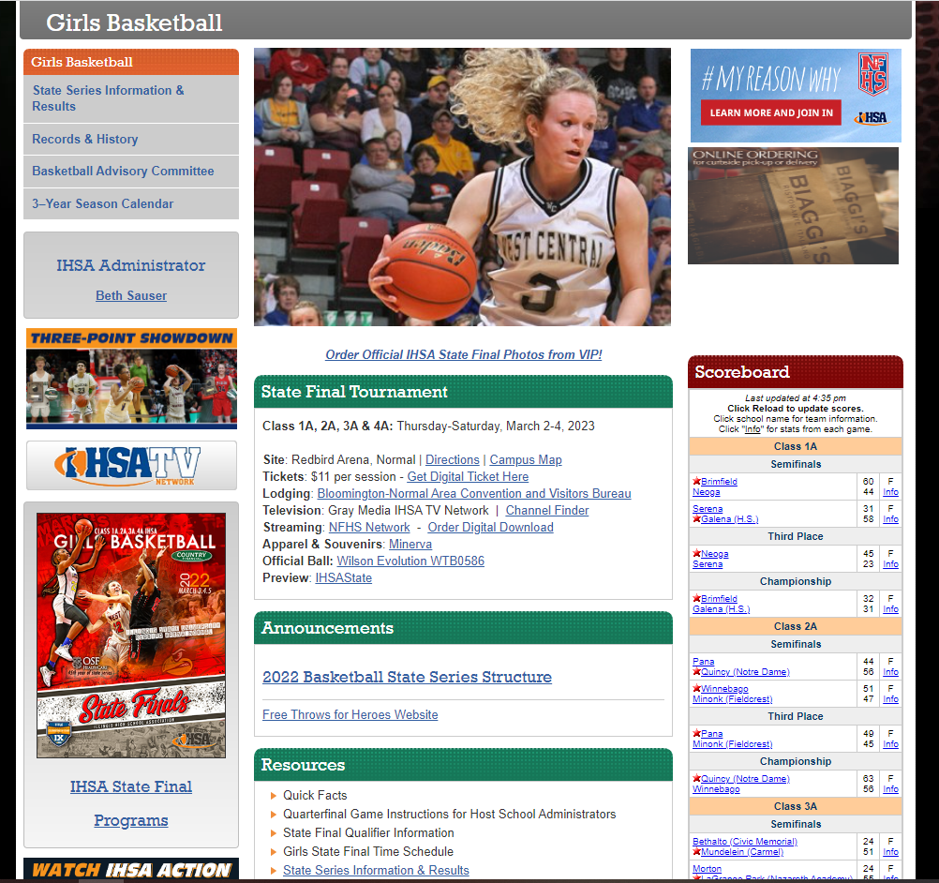
Resources
The girls’ or boys’ basketball pages at ihsa.org have resources that may be useful for schools.
Adopted shot clock rule
Video going over details of the rule
Reference document for shot clock operators
Look under the 'Announcements' heading in the center column.
Notes:
To assist member schools and events that are approved to use the shot clock, the IHSA girls’ and boys’ basketball pages will have a few resources, including this presentation, that will assist with the implementation of the shot clock. Look under the “Resources” heading on either page for more information.

Slide 6
Shot Clock Implementation: equipment, table crew and game officials
Shot clocks should be recessed and mounted on the backboard supports behind each backboard.
It is recommended that the official timer and shot clock operator be seated at the scorer’s table. The two do not, however, have to sit side by side.
Game officials should be provided with the adopted rule in advance of the approved event.
Notes:
Events wishing to use the shot clock must do so in conjunction with an IHSA member school. In other words, an IHSA member school must be listed as the organizer/co-organizer of any event wishing to use the shot clock. Part of the approval process requires that organizers acknowledge ALL games in the tournament or shoot-out will use the shot clock. IHSA member schools can request an approval form by contacting Kurt Gibson (kgibson@ihsa.org) at the IHSA Office.

Slide 7
Shot Clock Implementation equipment, table crew, and game officials
The rule adopted by the IHSA can also be found on the boys’ or girls’ basketball pages under the ‘Announcements’ heading.
Member schools and event organizers are encouraged to review that document and make sure shot clock operators and game officials are familiar with the rule.
Notes:
The rule adopted by the IHSA can also be found on the boys’ or girls’ basketball pages under the ‘Resources’ heading. Member schools and event organizers are encouraged to review that and make sure shot clock operators and game officials are familiar with the rule and expectations. In the event the shot clock malfunctions during a game, the rest of that game shall be played using conventional timing rules. In other words, there is no requirement that an alternate timing device be available. Given that the events that can utilize the shot clock are generally on a tight schedule, there will be no repercussions if an approved event has this kind of malfunction. The expectation would be remaining games would use the shot clock, assuming it can be fixed.

Slide 8
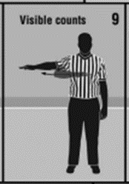
Shot Clock Implementation game officials
Use the shot clock to administer the 10-second backcourt count (9-8). The 10-second count shall begin when the ball touches, or is legally touched by, a player on the court, in the backcourt on a throw-in, or on player control on a rebound or jump ball. Note that this is a different application of the backcourt rule and is ONLY used when the shot clock is in effect.
Use a silent, visible 10-second count when there is no shot clock visible. (NFHS Signal 9)
Notes:
There are some differences between the adopted shot clock rule in Illinois and other playing codes, like for college basketball. One of the biggest changes involves the 10-second backcourt count. Officials shall use the shot clock to administer the 10-second backcourt count (9-8). The 10-second count shall begin when the ball touches, or is legally touched by, a player on the court, in the backcourt on a throw-in, or on player control on a rebound or jump ball. For shot clock operators who work college games this will also be an adjustment that person will need to make.
When no shot clock is being used, the silent, visible 10-second count will be used. In approved events, this would only be used in the case where the shot clock malfunctioned and was turned off for a particular game.

Slide 9
Shot Clock Implementation game officials
On a clock stoppage in the backcourt when possession of the ball will remain with the offense, officials will need to start a new backcourt count.
Example: following a made basket, Team A begins to advance the ball up the floor. Team B deflects the ball out of bounds with :26 remaining on the shot clock. Team A will have until :16 seconds remain on the shot clock to obtain front court status with the ball and not violate the 10-second backcourt rule.
Notes:
On a clock stoppage in the backcourt when possession of the ball will remain with the offense, officials will need to start a new backcourt count.
Example: following a made basket, Team A begins to advance the ball up the floor. Team B deflects the ball out of bounds with :26 remaining on the shot clock. Team A will have until :16 seconds remain on the shot clock to obtain front court status with the ball and not violate the 10-second backcourt rule.

Slide 10
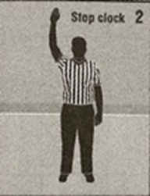
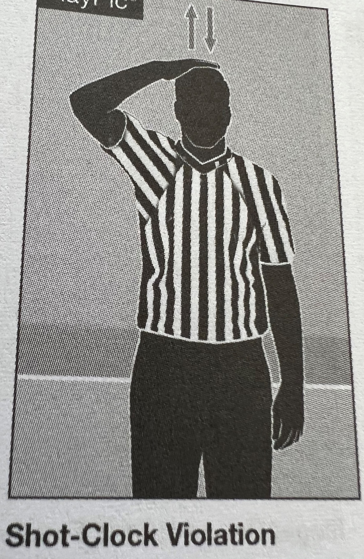
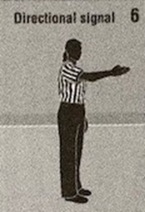
Shot Clock Implementation game officials
To indicate a shot clock violation, the official will give the stop clock signal…
…followed by…
the tapping of the head and give a directional signal.
Notes:
To indicate a shot clock violation, the official will give the stop clock signal followed by the tapping of the head and give a directional signal…signals which you can see here on this slide.

Slide 11
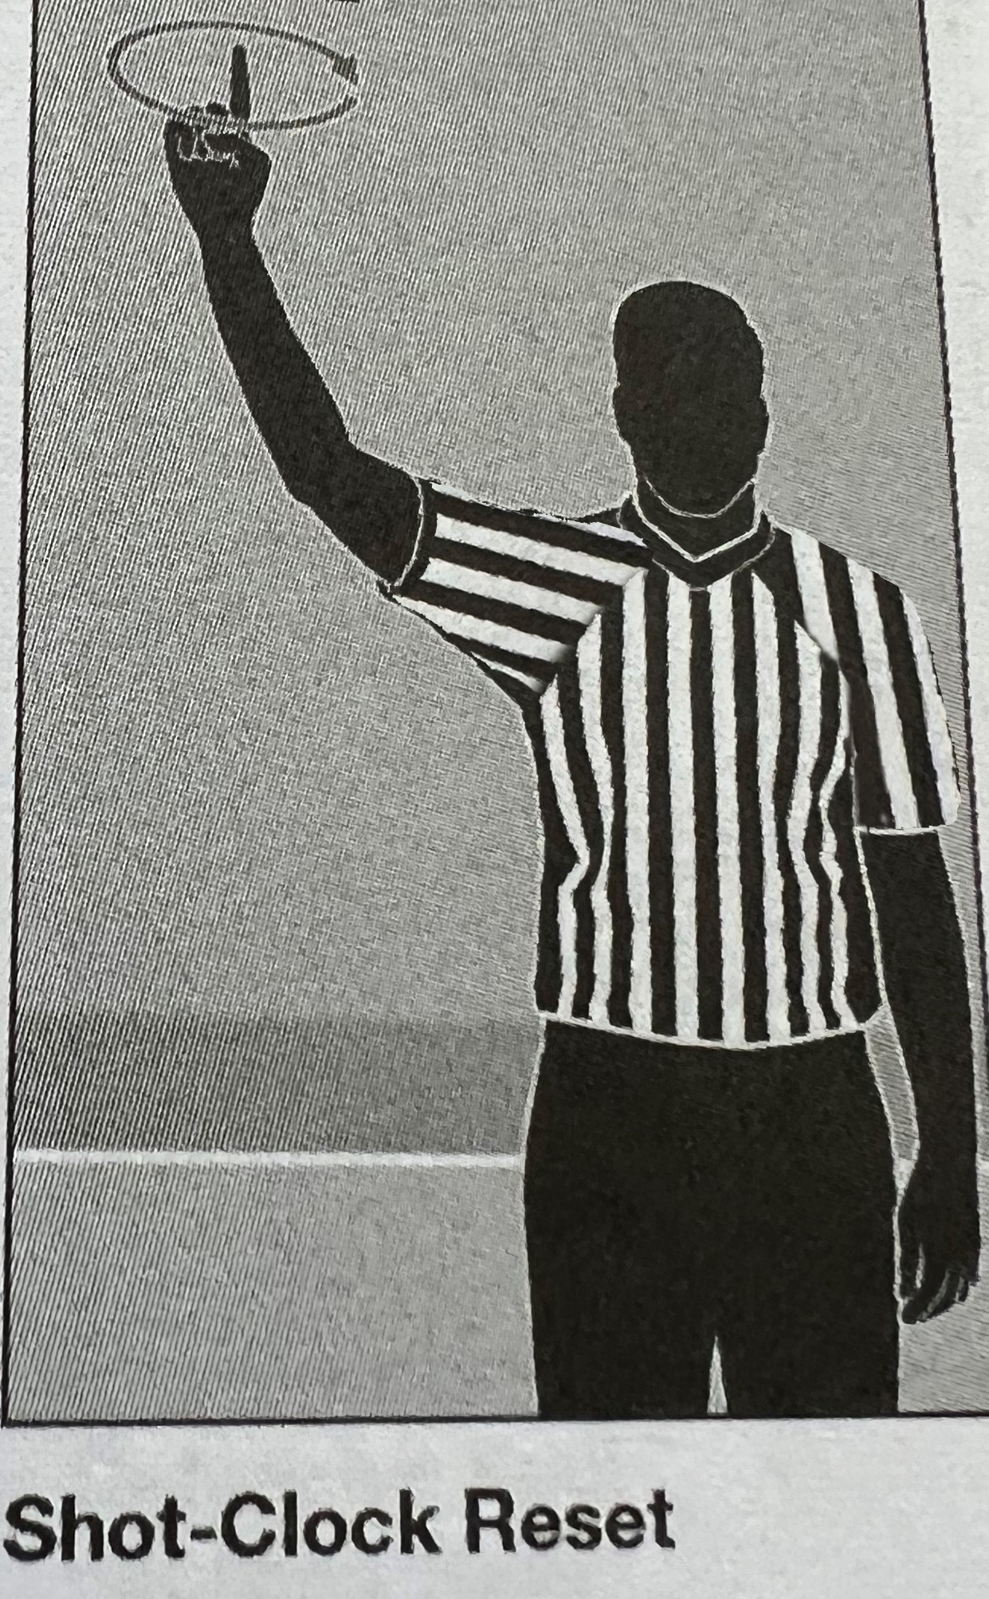
Shot Clock Implementation game officials
To indicate a shot clock reset, the official will use a rolling motion of a pointed index finger above the head.
Notes:
To indicate a shot clock reset, the official will use a rolling motion of a pointed index finger above the head. Game Officials will have the final decision when there is doubt as to whether a score was made within the shot clock period or the try for goal contacted the ring or flange. Obvious mistakes made by the shot clock operator or due to a malfunction may be corrected in the shot clock period in which the mistake or malfunction occurred ONLY if the officials have definitive knowledge relative to the situation.

Slide 12
Shot Clock Implementation game officials
Game Officials will have the final decision when there is doubt as to whether a score was made within the shot clock period or the try for goal contacted the ring or flange.
Obvious mistakes made by the shot clock operator or due to a malfunction may be corrected in the shot clock period in which the mistake or malfunction occurred ONLY if the officials have definitive knowledge relative to the situation.
Notes:
Game Officials will have the final decision when there is doubt as to whether a score was made within the shot clock period or the try for goal contacted the ring or flange. Obvious mistakes made by the shot clock operator or mistakes due to a malfunction may be corrected in the shot clock period in which the mistake or malfunction occurred ONLY if the officials have definitive knowledge relative to the situation.

Slide 13
Shot Clock Implementation general principles
In approved events, a 35-second shot clock shall be used.
In approved events, the shot clock shall be used the entire game, including extra periods, except when there is less time remaining on the game clock than the shot clock. This includes games where the Mercy Rule has gone into effect.
In the event the shot clock malfunctions during a game, the rest of that game shall be played using conventional timing rules. In other words, there is no requirement that an alternate timing device be available.
Notes:
As it’s been mentioned, only a 35-second shot clock can be used. In approved events, the shot clock shall be used the entire game, including extra periods, except when there is less than 35 seconds remaining on the game clock in any quarter or overtime period. The shot clock will continue to be used in games even if and when the Mercy Rule has gone into effect. Approved events do NOT have to have an alternate timing device on site during any game in which the shot clock is used. If the shot clock malfunctions during a contest, the remainder of the contest will be played using conventional timing rules.

Slide 14
Shot Clock Implementation general principles
The team in control must attempt a try for field goal within the 35-second shot clock period.
A shot clock period is the period of time beginning when the ball is legally touched on a throw-in or when team control is established or re-established after loss of team control and the shot clock is properly started.
The shot clock period ends when the shot clock is properly started for the next shot clock period.
Notes:
The team in control must attempt a try for field goal within the 35-second shot clock period. A shot clock period is the period of time beginning when the ball is legally touched on a throw-in or when team control is established or re-established after loss of team control and the shot clock is properly started. Shot clock operators need to be certain the throw-in has been touched or possession has changed before starting a new shot clock period. The shot clock period ends when the shot clock is properly started for the next shot clock period.

Slide 15
Shot Clock Implementation general principles
A shot clock try for field goal is defined as the ball having left the shooter’s hand(s) before the sounding of the shot clock horn and then striking the ring or flange or entering the basket.
It is a violation:
when a try for field goal does not leave a shooter’s hand before the expiration of the allotted shot clock time, or
when the try does leave a shooter’s hand and the try does not strike the ring or flange or enter the basket before the expiration of the allotted shot clock time period.
Notes:
A shot clock try for field goal is defined as the ball having left the shooter’s hand(s) before the sounding of the shot clock horn and then striking the ring or flange or entering the basket. It is a violation when a try for field goal does not leave a shooter’s hand before the expiration of the allotted shot clock time period or when the try does leave a shooter’s hand and the try does not strike the ring or flange or enter the basket before the expiration of the allotted shot clock time period.

Slide 16
Shot Clock Implementation general principles
The shot clock starts when:
The ball touches, or is legally touched by, a player on the court;
A team gains initial control after a jump ball or unsuccessful try for goal;
There is a change in team control
Notes:
The shot clock will start when any of the following occur:
The ball touches, or is legally touched by, a player on the court;
A team gains initial control after a jump ball or unsuccessful try for goal;
There is a change in team control

Slide 17
Shot Clock Implementation general principles
The shot clock shall be stopped and reset to the full amount when:
After a change in team control and the ball remains live or after a score by the opponent;
A single personal or technical foul;
When a try for goal strikes the ring or flange and then possession is gained by either team;
When a violation occurs and the defense is awarded the ball for a throw-in;
Notes:
The next two slides show when the shot clock shall be stopped and reset to 35-seconds. The situations that result in a full reset include:
After a change in team control and the ball remains live or after a score by the opponent;
A single personal foul;
A single technical foul;
During team control, a defensive player causes a held ball, and the A-P arrow favors the defensive team;
When a try for goal strikes the ring or flange and then possession is gained by either team;

Slide 18
Shot Clock Implementation general principles
The shot clock shall be stopped and reset to the full amount when:
After a held ball or any other situation where the A-P arrow is used to determine team possession and the A-P arrow favors the defense for the ensuing throw-in;
After the ball goes out of bounds and was last touched simultaneously by two opponents, both of whom are either inbounds or out of bounds or when there is doubt as to who last touched the ball and the possession arrow favors the defensive team;
When there is an inadvertent whistle and there was no player or team control at the time of the whistle.
Notes:
Additionally, the shot clock shall be reset to the full 35-seconds when any of the following occur:
When a violation occurs and the defense is awarded the ball for a throw-in;
After a held ball or any other situation where the A-P arrow is used to determine team possession and the A-P arrow favors the defense for the ensuing throw-in;
After the ball goes out of bounds and was last touched simultaneously by two opponents, both of whom are either inbounds or out of bounds or when there is doubt as to who last touched the ball and the possession arrow favors the defensive team;
When there is an inadvertent whistle and there was no player or team control at the time of the whistle.

Slide 19
Shot Clock Implementation general principles
The shot clock shall be reset to 20 seconds when there is an intentionally kicked or fisted ball with less than 20 seconds on the shot clock.
In all other cases, no reset to 20 seconds shall be made when the timing device is stopped.
Notes:
There is however, only one situation that will result in a partial reset of the shot clock. This will occur when there is an intentionally kicked or fisted ball with less than 20 seconds on the shot clock and the ball is to remain with the offense. In this situation, the shot clock would be reset to 20 seconds.
In all other cases, no reset to the shot clock shall be made when the timing device is stopped.

Slide 20
Shot Clock Implementation general principles
The shot clock shall continue during loose-ball situations when the offense retains control or when an attempt is made at the wrong basket or when an attempt has failed to hit the rim or flange.
The shot clock horn shall sound at the expiration of the shot clock period. The shot clock horn shall not stop play unless recognized by an official’s whistle. When the shot clock indicates zeroes, the shot clock time has expired.
The shot clock shall be turned off when a reset situation occurs, and the game clock shows less time than that of a shot clock period.

Slide 21
Thanks for viewing this presentation!
Questions? Please contact Kurt Gibson (kgibson@ihsa.org) for more information.
Notes:
Thanks for viewing this presentation. Please contact Kurt Gibson at the IHSA Office for more information.

