Slide 1
IHSA COMPLIANCE CHECK LIST
How to locate this important form on the IHSA web site.

Slide 2
IHSA COMPLIANCE CHECK LIST (Go to IHSA.org and select the Resources tab)

Slide 3
IHSA COMPLIANCE CHECK LIST (Select the Download Center link)

Slide 4
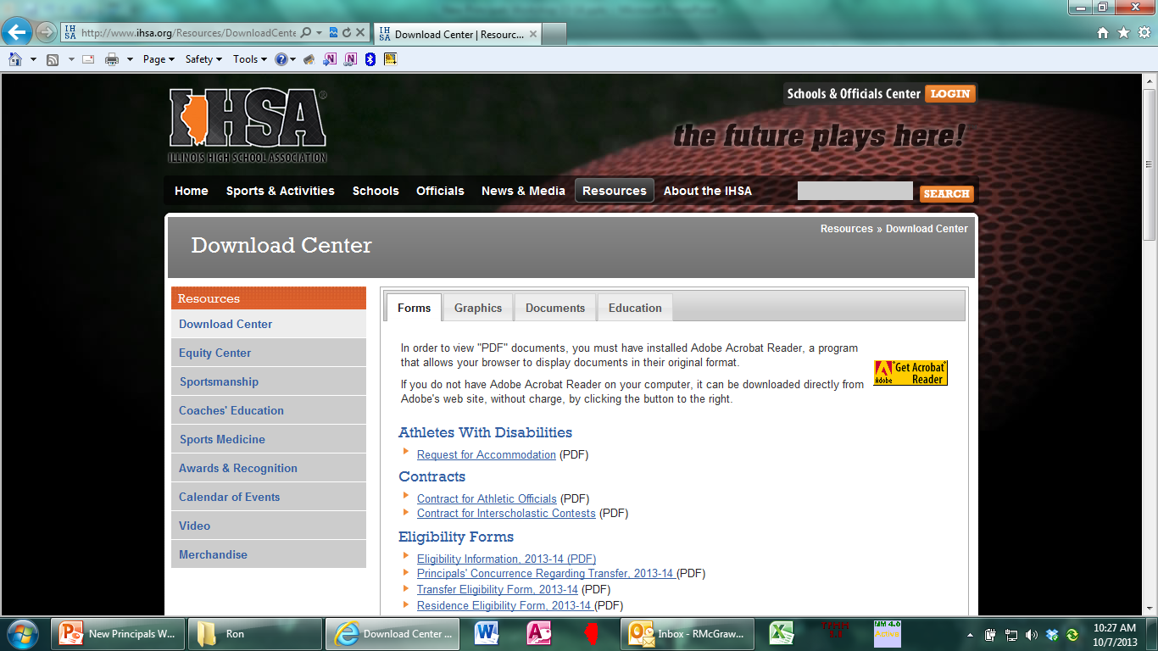
IHSA COMPLIANCE CHECK LIST (Select, the Documents tab)

Slide 5
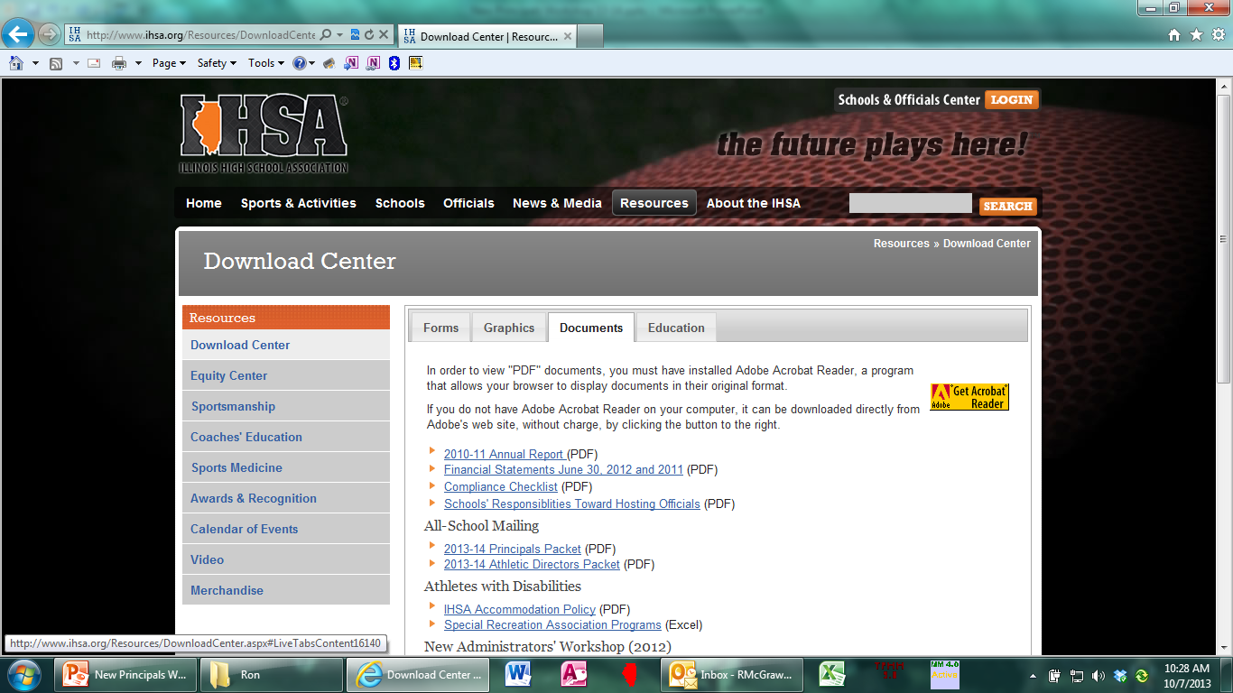
IHSA COMPLIANCE CHECK LIST (Select the Compliance Check List link)

Slide 6
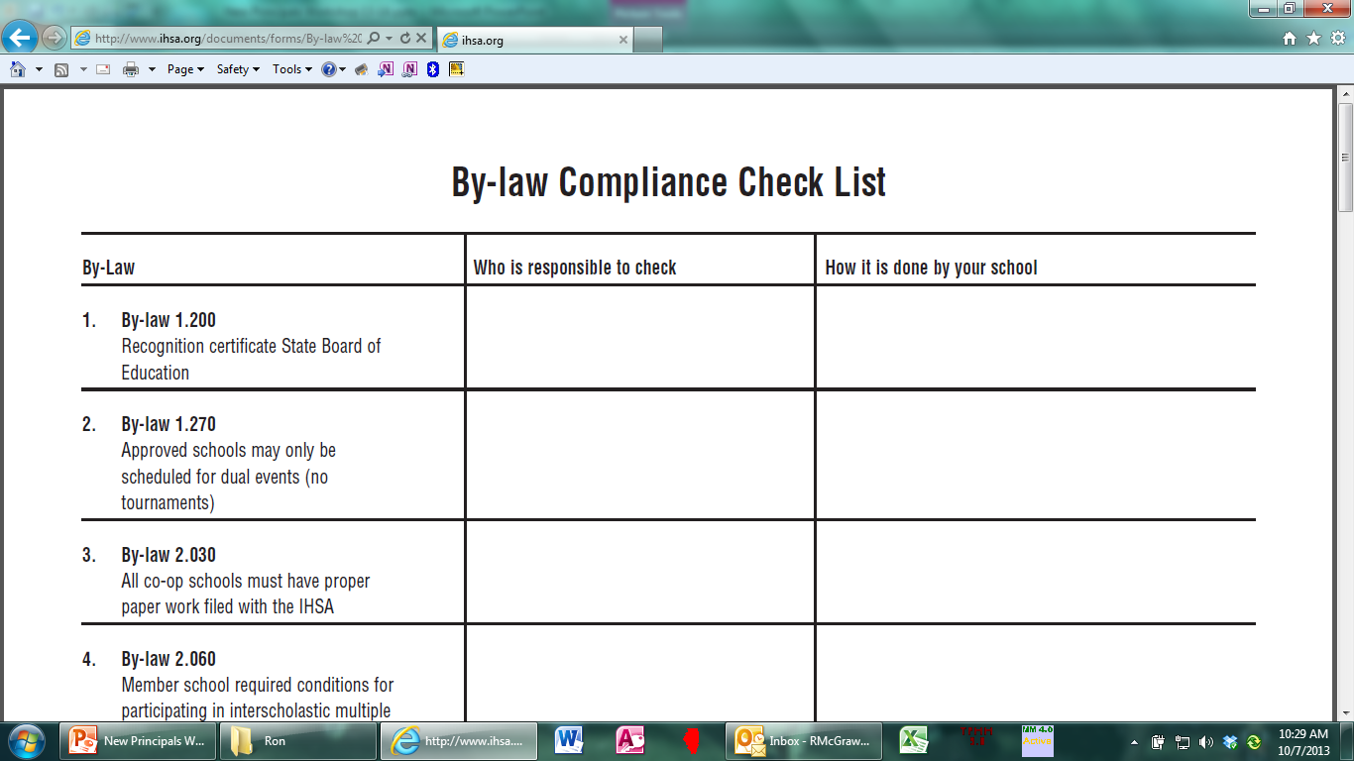
IHSA COMPLIANCE CHECK LIST

Slide 7
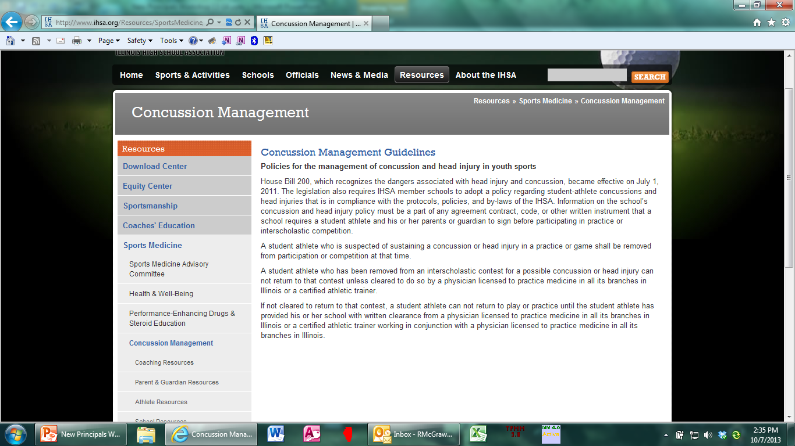
CONCUSSION MANAGEMENT (Go to: IHSA.org, Resources, Sports Medicine, Concussion Management

