Slide 1
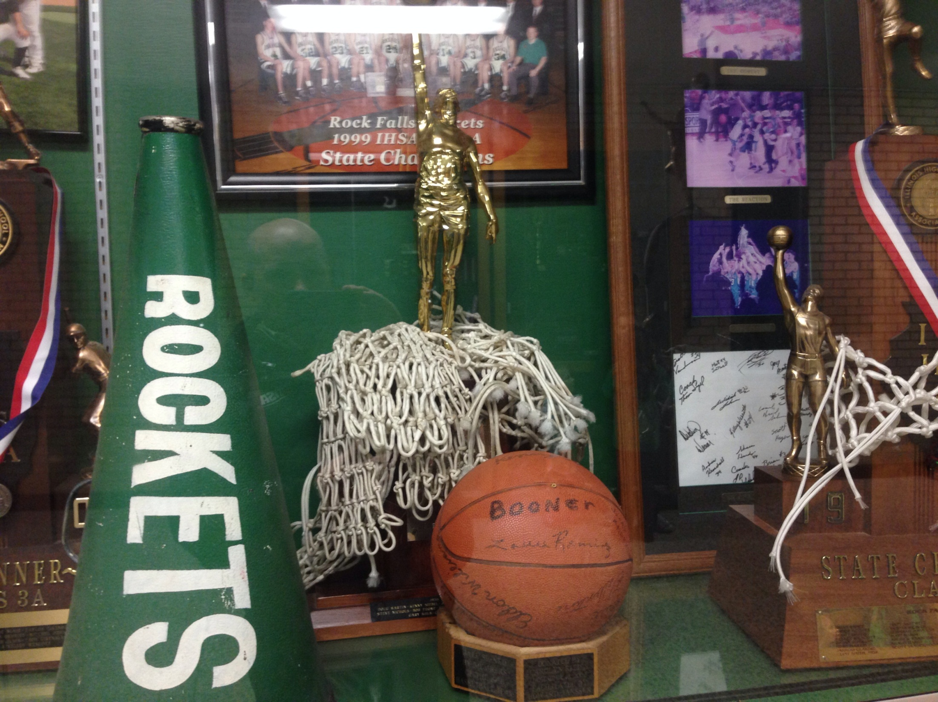
NFHS Announcer Presentation
Basketball Game Administration
2014-15

Slide 2
Announcer
The announcer shall be prohibited from making additional announcements during the game that can easily be seen on a scoreboard and beyond the normal realm of announcements.
Notes:
More clarity has been given to the announcer’s responsibilities.

Slide 3
Announcer Responsibilities
The announcer shall be prohibited from making an announcement:
while the clock is running and
while the clock is stopped and the ball is live
(such as during a free throw, a throw in, etc.)
Doing so could potentially affect communication between coaches and players or be disconcerting.
Notes:
The announcer shall be prohibited from making an announcement while the clock is running and while the clock is stopped and the ball is alive…such as during a free throw, a throw in, etc. Doing so could potentially affect communication of coaches, players or be disconcerting.

Slide 4
Announcer Responsibilities
The announcer shall be prohibited from interrupting the game through the use of the microphone unless there is an emergency.
Announcements or comments shall be made during those times when there is a stoppage of the clock and the ball is not live, such as time outs, between quarters, pre-game, half time and post game.
Notes:
The announcer shall be prohibited from interrupting the game through the use of the microphone unless there is an emergency.
Announcements or comments shall be made during those times when there is a stoppage of the clock and the ball is not live, such as time outs, between quarters, pre-game, half time and post game.

Slide 5
Announcer Responsibilities
The announcer is allowed to announce basic information that does not potentially affect the play in general, the players, the coaches, or the officials. The announcer’s information is not official information and, if announced, could mislead fans and others.
Appropriate training of announcers by school personnel and proper pre-game instructions by the referee are necessary.
Notes:
The announcer is allowed to announce basic information that does not potentially affect the play in general, the players, the coaches, or the officials. The announcer’s information is not official information and could be misinformation shared with all.
Appropriate training of announcers by school personnel and proper pre-game instruction by the Referee are necessary.

Slide 6
May be Announced - Examples:
Player who scored (quick notification w/o extreme emphasis)
Player charged with foul
Player attempting free throw
Team granted a time out
Length of time out: 30 seconds or 60 seconds
Player entering game
Team Rosters
Notes:
These are examples of announcements that can be made during those times when there is a stoppage of the clock and the ball is not live, such as time outs, between quarters, pre-game, half time and post game.
May be announced:
Player who scored (the NFHS has said announcers can announce who scored a basket while the ball is live so long as the announcement is quick, to the point, and without emphasis/prejudice)
Player charged with foul
Player attempting free throw
Team granted a time out
Length of time out: 30 seconds or 60 seconds
Player entering game
Team Rosters

Slide 7
Shall not be Announced – Examples:
Number of points player scored
Number of fouls on player
Number of team fouls
Number of team time outs or number remaining
Time remaining in the quarter/game
Type of foul or violation
Emphatic 2 or 3 point goal
Notes:
These are examples of announcements that shall not be announced at any point during a contest:
Number of points player scored
Number of fouls on player
Number of team fouls
Number of team time outs or number remaining
Time remaining in the quarter/game
Type of foul or violation
Emphatic 2 or 3 point goal

Slide 8
Announcer Responsibilities
The announcer’s role does not include “cheering the home team on” or otherwise inciting the crowd. Doing so is common at other levels of athletic events. But high school athletics is different because sports are educationally based.
In a very real sense, the public address announcer at a high school event is a “Champion of Character”.
Notes:
Announcer’s Responsibilities:
The announcer’s role does not include “cheering the home team on” or otherwise inciting the crowd. Doing so is common at other levels of athletic events. But high school athletics is different because sports are educationally based.
In a very real sense, the public address announcer at a high school event is a “Champion of Character”.

Slide 9
Announcer Responsibilities
The announcer can influence the atmosphere of the contest by what is said and how it is said.
The announcer who performs professionally promotes good sportsmanship by what he/she says and how he/she acts upon saying it.
Notes:
He/she can influence the atmosphere of the contest by what is said and how it is said.
The announcer who performs professionally promotes good sportsmanship by what he/she says and how he/she acts upon saying it.

Slide 10
Game Management Responsibilities
School administrators need to require their scoring table (clock operator, scorekeeper, announcer) to promote highest levels of sportsmanship.
Game officials should work with game management to remedy any problems that occur during a contest. (file Special Report with IHSA following any such contest)
Notes:
He/she can influence the atmosphere of the contest by what is said and how it is said. Contest officials should remind announcers prior to a contest what their expectations are for the game. If problems arise during a game, officials should work through game management to correct those.
The announcer who performs professionally promotes good sportsmanship by what he/she says and how he/she acts upon saying it.

